Slide 1
All the Tiny Features
Reviewing the latest features of the browser

Slide 2
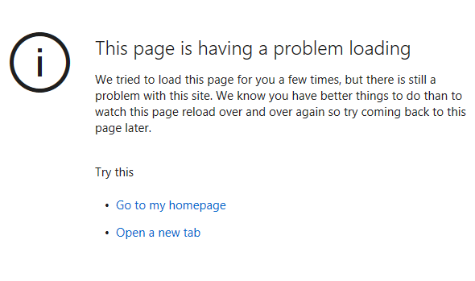
About Me
Natalie Silvanovich AKA natashenka
Project Zero member
Previously did mobile security on Android and BlackBerry

Slide 3
New Browser Features
WebAssembly
WebRTC

Slide 4
WebAssembly

Slide 5

What is WebAssembly?
Format for writing assembly-like code in JavaScript
Motivated by need for greater efficiency and safety
Compilability is a major goal
W3C standard
Applications beyond browsers

Slide 6
Possible problems with WebAssembly
WebAssembly engines aren’t implemented securely
WebAssembly engines aren’t implemented securely
2) Code written in WebAssembly isn’t implemented securely
2) Code written in WebAssembly isn’t implemented securely
WebAssembly: A New World of Native Exploits on the Browser
Justin Engler, Tyler Lukasiewicz
Black Hat USA, 2018

Slide 7
What *Is* WebAssembly
WebAssembly starts as a binary
ArrayBuffer or TypedArray
Can load using fetch (or not)
var wasm = new Uint8Array(123);
wasm[0] = 0x0;
wasm[1] = 0x61;
wasm[2] = 0x73;
wasm[3] = 0x6d;
wasm[4] = 0x1;
wasm[5] = 0x0;
wasm[6] = 0x0;
wasm[7] = 0x0;
wasm[8] = 0x1;
wasm[9] = 0xa;
wasm[10] = 0x2;

Slide 8
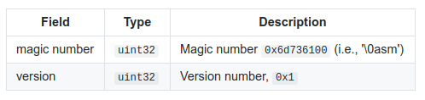
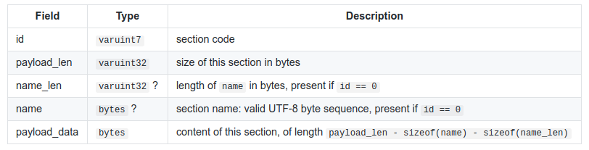
WebAssembly Binary Format
Consists of sections of various types (some optional)
Mandatory order and duplicates forbidden
section

Slide 9
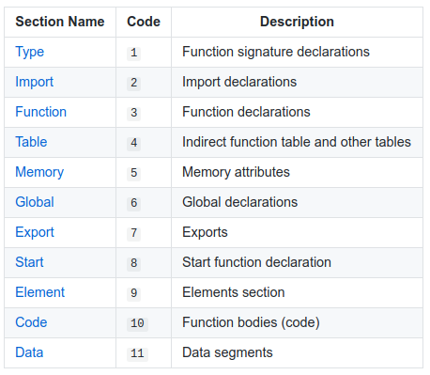
Section Types

Slide 10
WebAssembly Module
First step is parsing binary format and loading it into Module
var m = new WebAssembly.Module(wasm);

Slide 11
What could go wrong?
CVE-2018-4121 -- WebKit: WebAssembly parsing does not correctly check section order
Order check can be bypassed
static inline bool validateOrder(Section previous, Section next) { if (previous == Section::Custom) return true; return static_cast<uint8_t>(previous) < static_cast<uint8_t>(next); }

Slide 12
What could go wrong?
CVE-2018-6092 -- V8: Integer Overflow when Processing WebAssembly Locals
Integer overflow
if ((count + type_list->size()) > kV8MaxWasmFunctionLocals) { decoder->error(decoder->pc() - 1, "local count too large"); return false; }

Slide 13
What could go wrong?
CVE-2018-4222 -- WebKit: Info leak in WebAssembly Compilation
Can read out of bounds of the wasm buffer
var b2 = new ArrayBuffer(1000); var view = new Int8Array(b2, 700); var mod = new WebAssembly.Module(view);

Slide 14
WebAssembly Instance
Loads module into runnable form
Loads imports
Initializes imports
Creates exports

Slide 15
WebAssembly Imports
Three import types
Function: JavaScript or WebAssembly function
Memory: memory page object
Table: function table object
If two wasm Instances have the same Memory and Table, they are in the same compartment
There is no practical reason for a Module to share one of these objects but not the other

Slide 16
WebAssembly Memory
Memory page for WebAssembly code
Has a initial and max size, and can be expanded by calling grow in WebAssembly or JavaScript
Accessed by WebAssembly instructions
var memory = new WebAssembly.Memory({initial:10, maximum:100});
memory.grow(10);
Notes:
https://bugs.chromium.org/p/chromium/issues/detail?id=752423

Slide 17
What could go wrong?
Overflows in expanding Memory
CVE-2018-5093 -- FireFox: Buffer overflow in WebAssembly during Memory/Table resizing (found by OSS-Fuzz)
CVE-2017-15399 -- V8: UaF in Growing Memory (Zhao Qixun of Qihoo 360 Vulcan Team)

Slide 18
What could go wrong?
Surprisingly few OOB issues
Limited and known set of WebAssembly instructions
Limited threading
Safe signal buffers
Notes:
Explain a safe

Slide 19
Tables
Function table for WebAssembly
Can only contain WebAssembly functions
Only need to set at startup in practice, but can be changed any time
Can grow similar to a Memory page
var t = new WebAssembly.Table({initial:2, element:"anyfunc"});

Slide 20
What could go wrong?
Overflows in expanding Table
CVE-2018-5093 -- Buffer overflow in WebAssembly during Memory/Table resizing (found by OSS-Fuzz)
CVE-2017-5122: OOB access in v8 wasm after Symbol.toPrimitive overwrite (found by Choongwoo Han of Naver Corporation working with Chromium Vulnerability Rewards)

Slide 21
Initialization
Data segments from WebAssembly binary are used to initialize Memory
Element segments from WebAssembly binary are use to initialize Elements

Slide 22
What could go wrong?
No OOB issues seen so far!
V8: 826434: UaF in Calling Table
If a table is changed during a call to a function in the table, there is a UaF, as it drops the handle to its instance
Fixed by preventing table change during call
Still possible due to element initialization

Slide 23
Exports
End result of creating Module and then creating an Instance is exported WebAssembly functions ready to call!
var mod = new WebAssembly.Module(wasm);
var i = new WebAssembly.Instance(mod,
{imported : {func : f}, js : {table : t, mem : m} });
i.exports.exported_func(); // WebAssembly happens!

Slide 24
Runtime Issues?
Instructions do wrong thing*
Incorrect bounds checking
Incorrect handles / UaF

Slide 25
Future Issues
Concurrency
WebAssembly-GC

Slide 26
WebRTC

Slide 27
What is WebRTC?
Audio and video conferencing library
First implemented 2011, hit most browsers in 2015
Little security information available

Slide 28
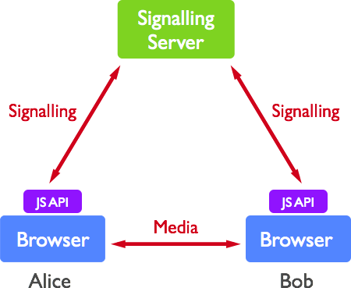
WebRTC Architecture

Slide 29
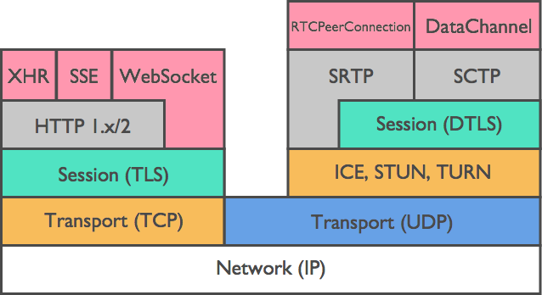
WebRTC Architecture

Slide 30
Idea 1: SDP
SDP is the most sensitive interface of WebRTC
WebRTC requires parsing untrusted SDP with no user interaction
Used WebRTC library to create SDP fuzzer on commandline
Reviewed SDP code
No bugs!
Some platforms implement separately

Slide 31
Idea 2: RTP and Media Protocols
WebRTC has already implemented fuzzers for RTP, media protocols and codecs
But what about end-to-end?
Wrote end-to-end fuzzer for RTP

Slide 32
Evolution of a fuzzer
Prototype
Altered Chrome to randomly change a byte of every tenth RTP packet (beneath encryption layer)
Had one browser instance ‘call’ another
Crashed roughly every 30 seconds
Learned that the concept would generally work
Got very shallow bugs that blocked fuzzing fixed

Slide 33
Evolution of a fuzzer
Client Fuzzer
Wrote C++ client that interacts with browser
Lighter weight than browser
Can run against any target
Pro: crashes are guaranteed to work on browser
Con: slow
Found additional end-to-end vulnerabilities in WebRTC

Slide 34
Evolution of a fuzzer
Distributed Fuzzer
Wrote command line RTP emulator with help of WebRTC team
Pro: extremely fast, portable
Con: not an exact representation of any WebRTC implementation
Ran on multiple cores on borg
Many bugs!

Slide 35
Results!
7 vulnerabilities found

Slide 36
CVE-2018-6130
std::map<int64_t, GofInfo> gof_info_ RTC_GUARDED_BY(crit_);
gof_info_.emplace(unwrapped_tl0,
GofInfo(&scalability_structures_[current_ss_idx_],
frame->id.picture_id));
if (frame->frame_type() == kVideoFrameKey) { GofInfo info =
gof_info_.find(codec_header.tl0_pic_idx)->second; FrameReceivedVp9(frame->id.picture_id, &info); UnwrapPictureIds(frame); return kHandOff; }

Slide 37
CVE-2018-6130
std::map<int64_t, GofInfo> gof_info_ RTC_GUARDED_BY(crit_);
gof_info_.emplace(unwrapped_tl0,
GofInfo(&scalability_structures_[current_ss_idx_],
frame->id.picture_id));
if (frame->frame_type() == kVideoFrameKey) { GofInfo info =
gof_info_.find(codec_header.tl0_pic_idx)->second; FrameReceivedVp9(frame->id.picture_id, &info); UnwrapPictureIds(frame); return kHandOff; }

Slide 38
CVE-2018-6130
const_iterator std::map::find ( const key_type & __x ) const [inline]
Tries to locate an element in a map.
Parameters:
x Key of (key, value) pair to be located.
Returns:
Read-only (constant) iterator pointing to sought-after element, or end() if not found.

Slide 39
CVE-2018-16071
auto gof_info_it = gof_info_.find(...);
// snip
info = &gof_info_it->second;
// Clean up info for base layers that are too old.
uint8_t old_tl0_pic_idx = codec_header.tl0_pic_idx -
kMaxGofSaved;
auto clean_gof_info_to =
gof_info_.lower_bound(old_tl0_pic_idx);
gof_info_.erase(gof_info_.begin(), clean_gof_info_to);
FrameReceivedVp9(frame->id.picture_id, info);
Untrusted value
From packet

Slide 40
CVE-2018-6129
size_t temporal_idx = info.gof->temporal_idx[gof_idx];
...
for (size_t l = 0; l < temporal_idx; ++l) {
...
auto missing_frame_it =
missing_frames_for_layer_[l].lower_bound(ref_pid);
// Earlier
RETURN_FALSE_ON_ERROR(parser->ReadBits(&t, 3));
...
vp9->gof.temporal_idx[i] = t;

Slide 41
CVE-2018-6156
FEC packets have a (theoretical) limit of 1500 bytes
So WebRTC copies packets off the wire into a 1500 byte buffer with no length checks

Slide 42
Decoder Bugs
CVE-2018-6155 -- UaF in VP8
Impacts more than WebRTC
CVE-2018-6157 -- Type Confusion in NAL (H264)
OOB read only

Slide 43
But wait, there’s more
WebRTC is used by many, many third parties
Facebook, WhatsApp, Signal, Viber, Slack, etc.
Every* mobile device has several copies of WebRTC
WebRTC documentation provided no guidance on updates
Worked with WebRTC to provide better guidance
Still gaps in patching

Slide 44
WebRTC Fuzzing
Fuzzing tool has been committed to WebRTC as video_replay
Try this at home!

Slide 45
Conclusions
Many new browser features have limited external security attention
Different bug finding techniques work well on different targets
The high tooling effort of both of these projects was worth it
Both projects could have benefited from more thought on patching strategies for non-browser users

Slide 46

Questions
https://googleprojectzero.blogspot.com/
@natashenka
natashenka@google.com

Slide 47
Bug 1654 (The WhatsApp Bug)

Slide 48
WhatsApp Video Conferencing
Uses PJSIP and WebRTC
RTP Processing is PJSIP
PJSIP is open source

Slide 49
Finding Encryption
Looked at Android App
No symbols, but log entries from libsrtp and PJSIP
Identified memcpy from packet to buffer before encryption (looked for srtp_protect log entries)

Slide 50
First Try
Wrote a Frida script that hooked all memcpy instances
Frida is awesome!
hook_code =""
 | Interceptor.attach (Module.findExportByName ( "libc.so", "read"), {
 | onEnter: function (args) {
 | send (Memory.readUtf8String (args [1]));
 | },
 | onLeave: function (retval) {
 | }

Slide 51
Hooking memcpy
Frida is too slow to make a call without a lot of lag
Good for debugging binary changes though
Changed specific memcpy to point to function I wrote in ARM64
Assembly of my function overwrote GIF transcoder

Slide 52
Hooking malloc
Original branch to malloc was BL instruction
Used the ARM branch finder to make it point to my function instead http://armconverter.com/branchfinder/
My function calls dlopen, dlsym and then a function in libnatalie.so

Slide 53
Hooking malloc
Had issues with calls disconnecting, turned out I was corrupting a used register
After a few fixes could log and alter incoming packets
Replaying packets by pure copying did not work

Slide 54
Hooking malloc
WhatsApp has FOUR RTC streams, even when muted
Luckily, they have different payload types
Fixing ssrc and sending logged packets worked

Slide 55
Fuzzing
Replaced libnatalie.so with a function that altered outgoing RTP
Crash took 15 minutes

